Slide 1


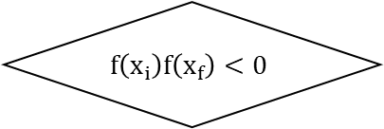
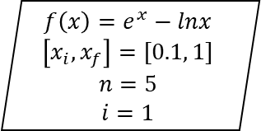

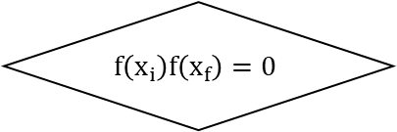


INICIO
$$f\left(x\right)=e^{x}−lnx$$
$$\left[x_{i}, x_{f}\right]=[0.1, 1]$$
$$n=5$$
$$i=1$$
$$i>5$$
Si
FIN
No
$x_{m}=\frac{x_{i}+x_{f}}{2}$
$$x_{r}=x_{m}$$
$$f\left(x_{i}\right)f\left(x_{f}\right)=0$$
Si
$$x_{f}=x_{m}$$
$$i=i+1$$
$$x_{i}=x_{m}$$
$$i=i+1$$
No
No
$$f\left(x_{i}\right)f\left(x_{f}\right)<0$$
Si

Slide 2
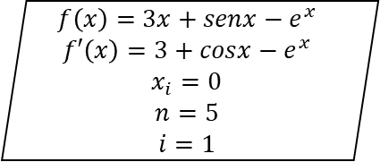



INICIO
$$f\left(x\right)=3x+senx−e^{x}$$
$$f′\left(x\right)=3+cosx−e^{x}$$
$$x_{i}=0$$
$$n=5$$
$$i=1$$
$$i>5$$
Si
$$x_{r}=x_{i+1}$$
No
$x_{i+1}=x_{i}\frac{f(x_{i})}{f′(x_{i})}$
FIN
$$x_{i}=x_{i+1}$$
$$i=i+1$$

Slide 3
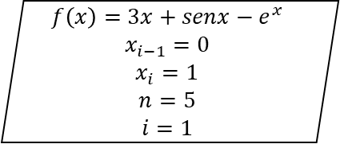

INICIO
$$f\left(x\right)=3x+senx−e^{x}$$
$$x_{i−1}=0$$
$$x_{i}=1$$
$$n=5$$
$$i=1$$
$$i>5$$
Si
$$x_{r}=x_{i+1}$$
No
$x_{i+1}=x_{i}\frac{f(x_{i})(x_{i}−x_{i−1})}{f\left(x_{i}\right)−f(x_{i}−1)}$
FIN
$$x_{i}=x_{i+1}$$
$$i=i+1$$

